Slide 1

Regular Languages and Automata
Instructor: Kuan Cheng

Slide 2
Review
DFA and NFA

Slide 3
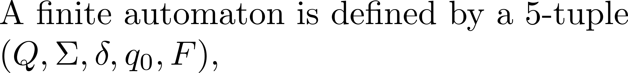
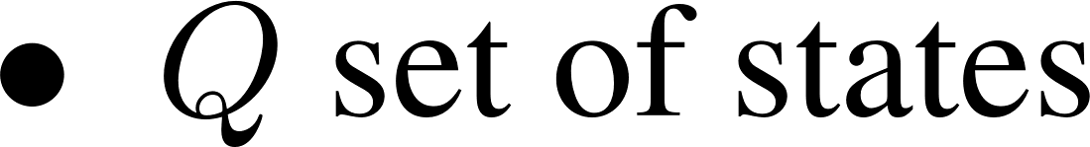
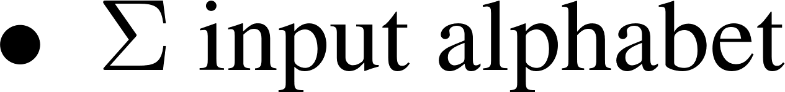
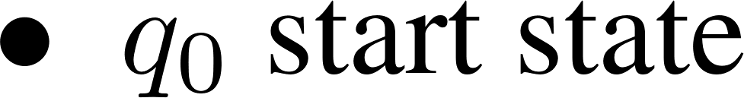
A simple model: Deterministic Finite state Automata (DFA)
A formal definition?
Front, Rear, Both
Neither
open
close
Neither
Front, Rear, Both
States\Inputs | Neither | Front | Rear | Both
Close 0 | 0 | 1 | 1 | 1
Open 1 | 0 | 1 | 1 | 1

Slide 4
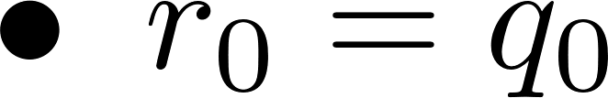
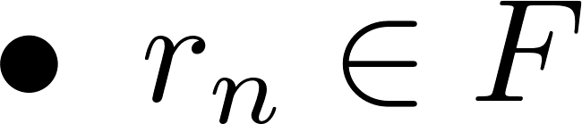
Definition of computation and regular language

Slide 5
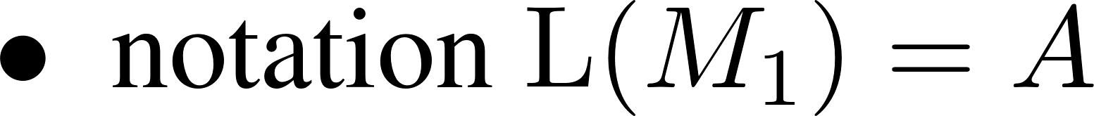
Set of strings accepted

Slide 6
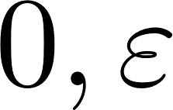
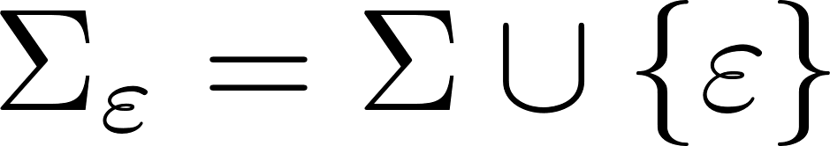
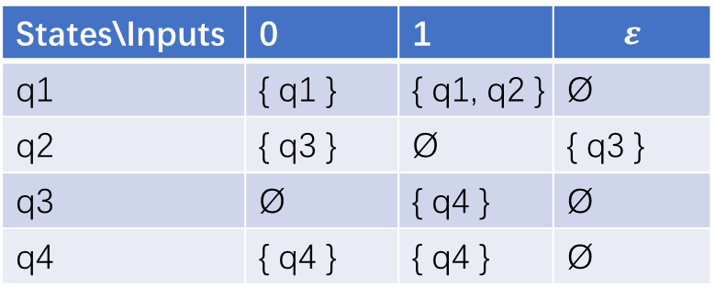
Non-deterministic Finite Automata (NFA)
0, 1
0, 1
q2
q4
q1
q3
q4
1
1
States\Inputs | 0 | 1 | $$ε$$
q1 | { q1 } | { q1, q2 } | Ø
q2 | { q3 } | Ø | { q3 }
q3 | Ø | { q4 } | Ø
q4 | { q4 } | { q4 } | Ø

Slide 7
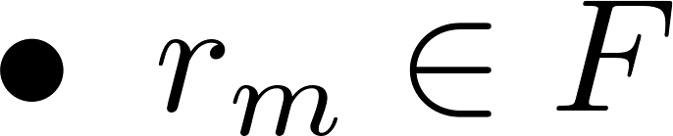
Computation of NFA

Slide 8
Is NFA more powerful than DFA?

Slide 9
No. They are equivalent.

Slide 10
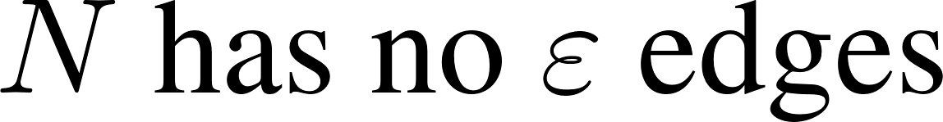
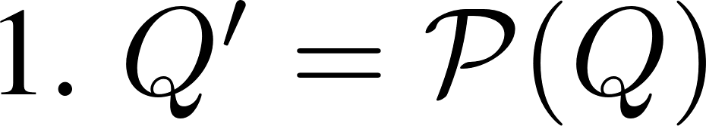
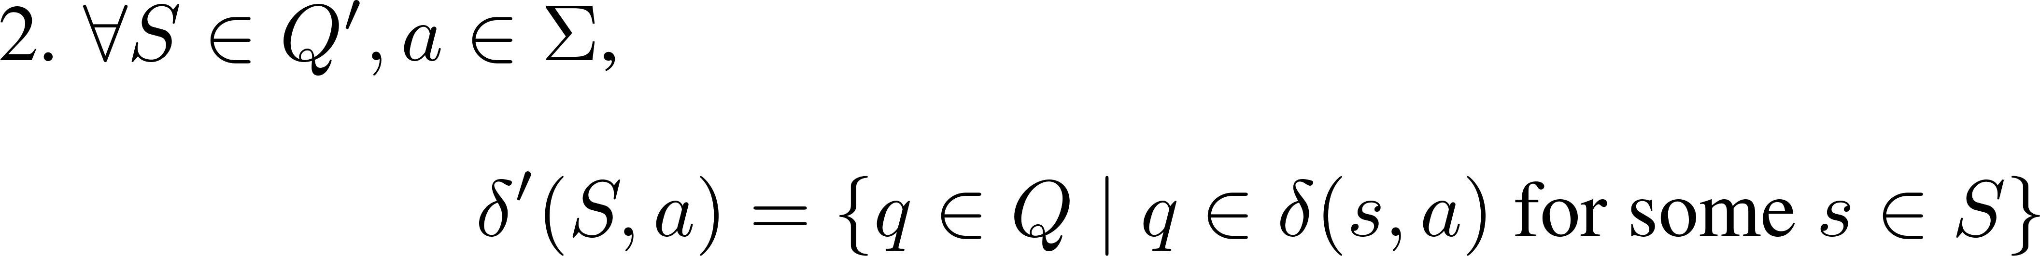
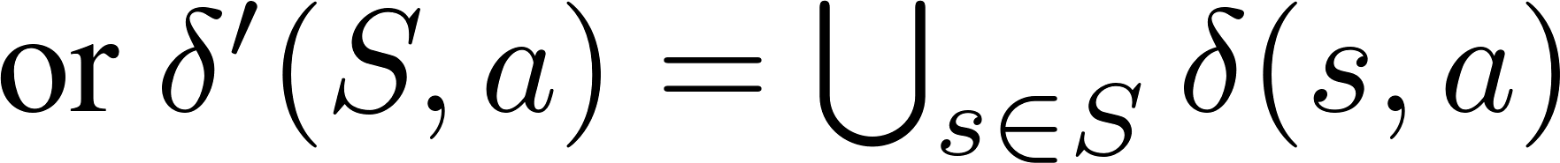
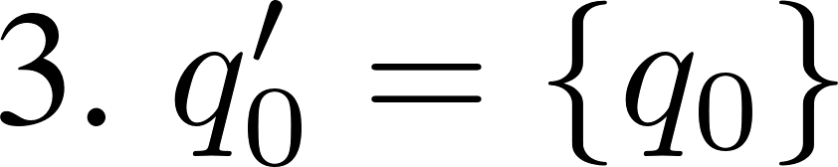
No. They are equivalent.

Slide 11

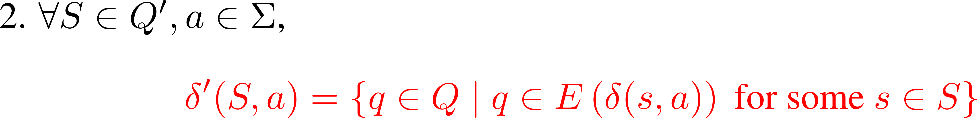
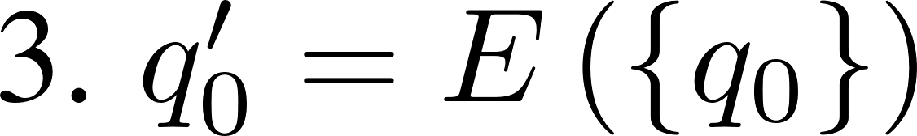
DFA and NFAs are equivalent.

Slide 12
DFA and NFAs are equivalent.

Slide 13
Computation Power of DFA/NFA

Slide 14
Detect the boundary
How to detect the boundary of computation power?
One way is to explore how fancy the recognized languages can be!
What does fancy mean in mathematics?
Maybe no equivalent definition but at least we can give some examples
E.g. in the sense of set operations

Slide 15


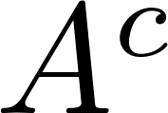
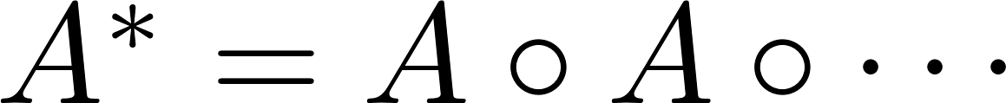
Regular Languages under Set Operations
Basic operations: union, intersection, complementation, concatenation…

Slide 16

Regular Languages under Set Operations
Basic operations: union, intersection, complementation, concatenation…

Slide 17
Proof
Turn every accept state to unaccept state
Turn every unaccept state to accept state

Slide 18
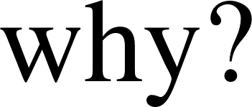
Regular Languages under Set Operations

Slide 19
Proof

Slide 20

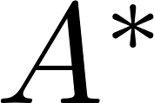
Regular Languages under Set Operations

Slide 21
Proof

Slide 22
Regular Languages vs
Regular Expressions

Slide 23
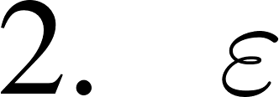
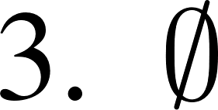
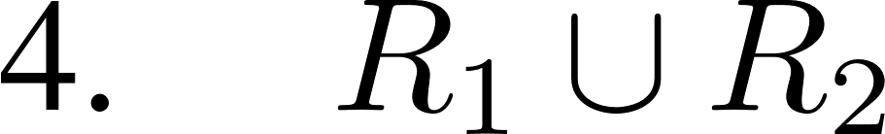
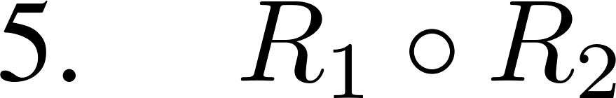
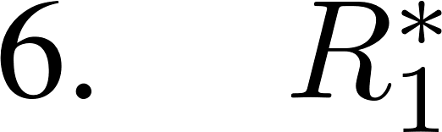
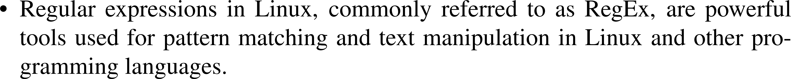
Regular Expressions

Slide 24
Regular Expressions vs Regular Languages?

Slide 25
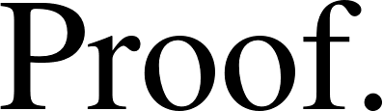
Regular Expressions vs Regular Languages?

Slide 26
Regular Expressions vs Regular Languages?

Slide 27
Computation Power of DFA/NFA

Slide 28
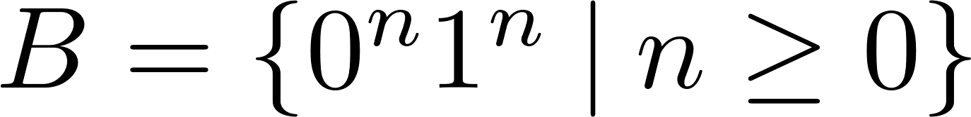
Non-regular languages?
Can you give some example?
Is the following language regular?

Slide 29
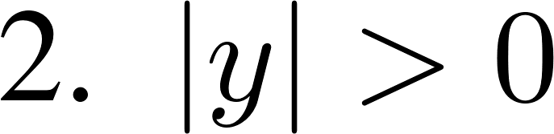
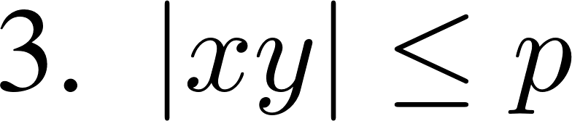
Pumping Lemma

Slide 30
Pumping Lemma

Slide 31
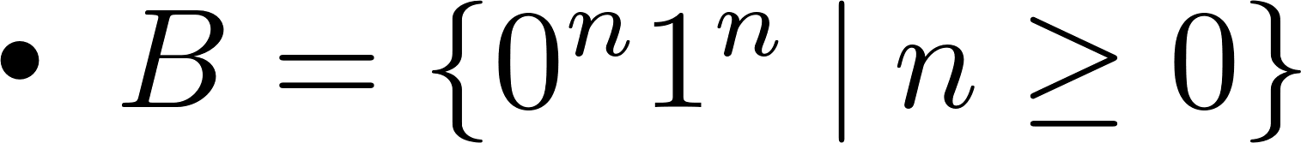
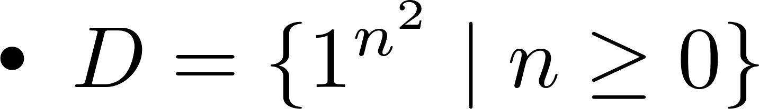
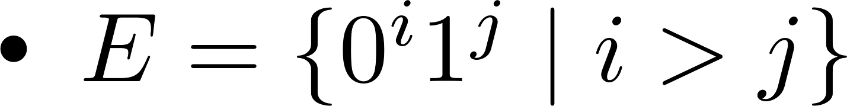
Non-regular Languages

